Slide 1

CSC 533: Privacy in the Digital Age (Fall 2020) Lecture 19: Privacy Policy Compliance
Anupam Das
Oct. 22, 2020

Slide 2
Goals for today
Compliance tools web services
Compliance tools mobile applications
Cookie Compliance for GDPR
Some slide contents have been taken from Lorrie Cranor, Norman Sadeh and Florian Schaub

Slide 3
Privacy policy
Policies let consumers know about site’s data practices
Consumers can then decide whether or not practices are acceptable, when to opt-in or opt-out, and who to do business with
The presence of privacy policies increases consumer trust

Slide 4
Privacy policy problem
BUT policies are often
difficult to understand
hard to find
take a long time to read
change without notice
can’t be sure if everything is accurate or properly enforced

Slide 5
What can we do then?
Build systems/protocols that can provide concise and clear statements
Build systems that can negotiate on users’ behalf and make appropriate decisions
Build auditing systems for better transparency

Slide 6
Platform for Privacy Preferences Project (P3P)
Developed by the World Wide Web Consortium (W3C) http://www.w3.org/p3p/
Final P3P1.0 Recommendation issued 16 April 2002
Offers an easy way for web sites to communicate about their privacy policies in a standard machine-readable format
Can be deployed using existing web servers
Enables the development of tools (built into browsers or separate applications) that
Summarize privacy policies
Compare policies with user preferences
Alert and advise users

Slide 7
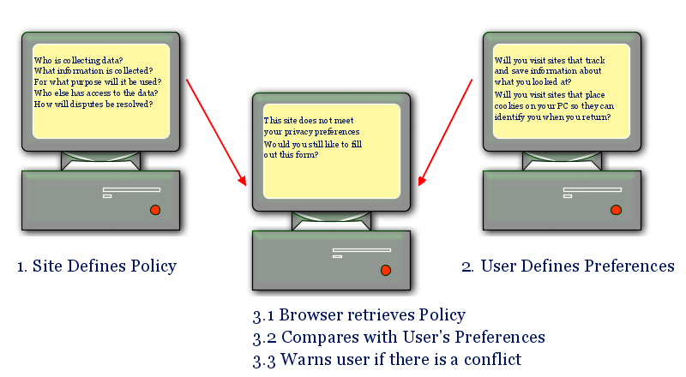
P3P example
P3P provides a standard XML format that web sites use to encode their privacy policies
There is a lack of enforcement. Only promise not guarantee
Only IE and edge supported it. As of Windows 10 it has been removed

Slide 8
What did P3P policy contain?
Name and contact information for site
The kinds of data collected
How collected data is used, and whether individuals can opt-in or opt-out of any of these uses
Whether/when data may be shared and whether there is opt-in or opt-out
Data retention policy
Mechanisms for resolving privacy disputes

Slide 9
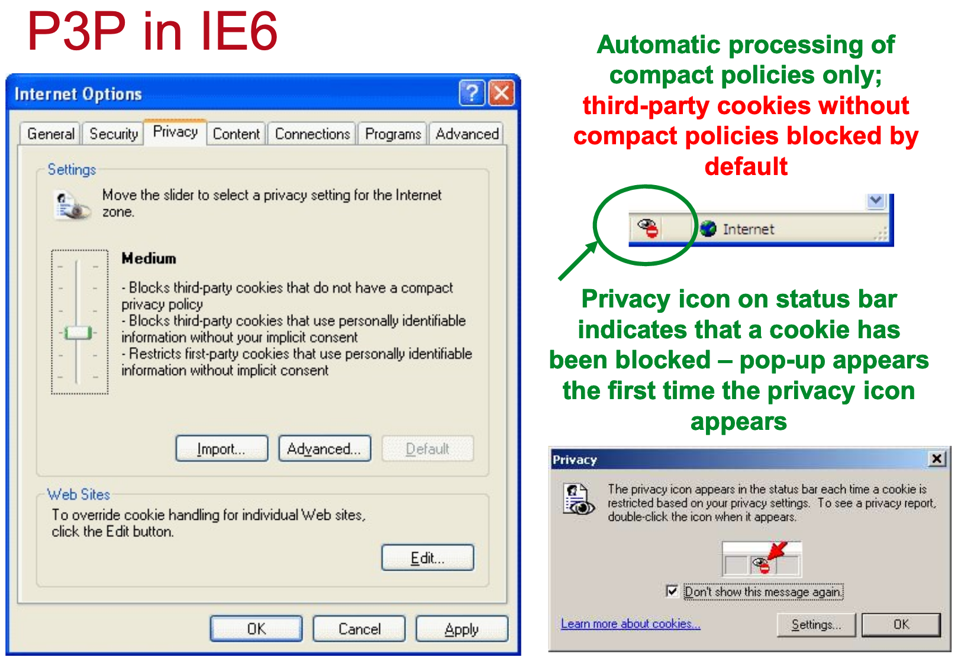
P3P in IE6

Slide 10
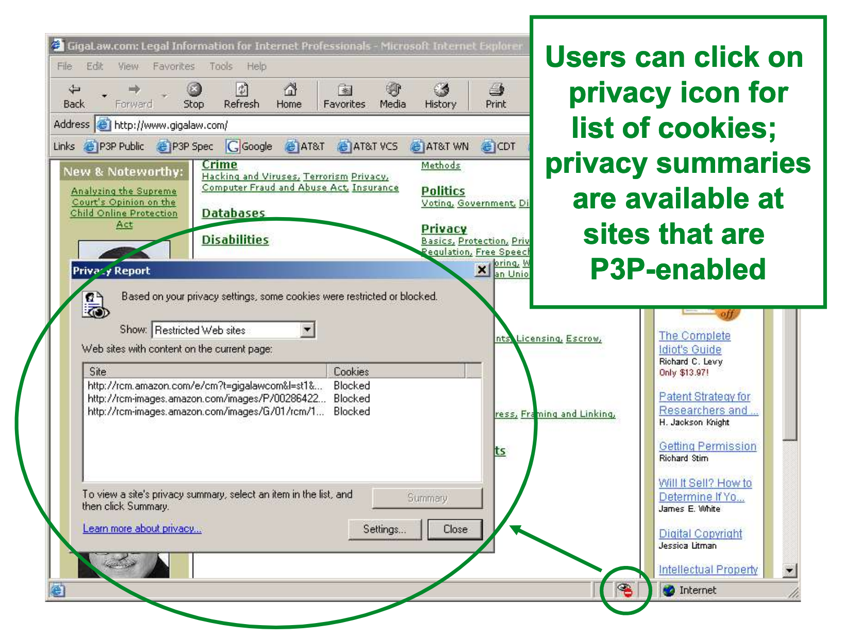
Cookie summaries

Slide 11
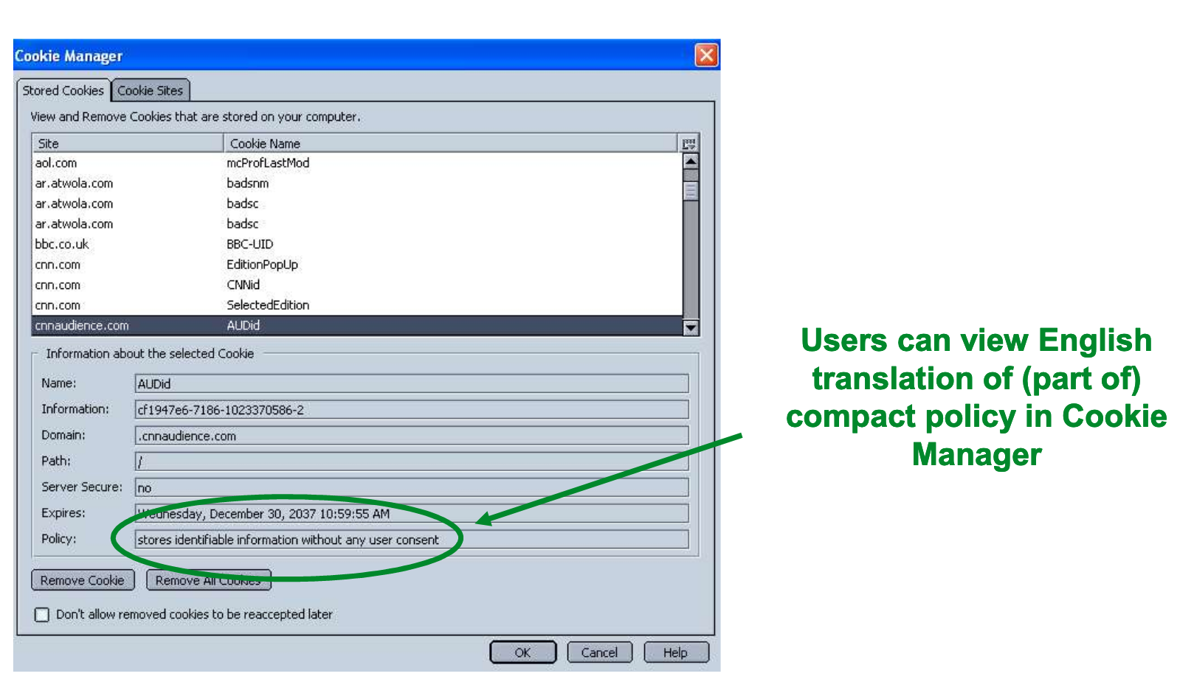
Cookie details

Slide 12
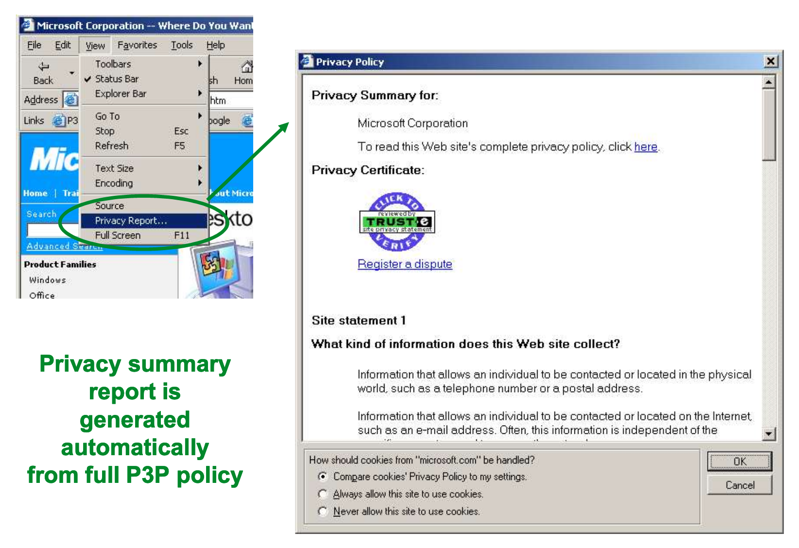
Policy summary

Slide 13
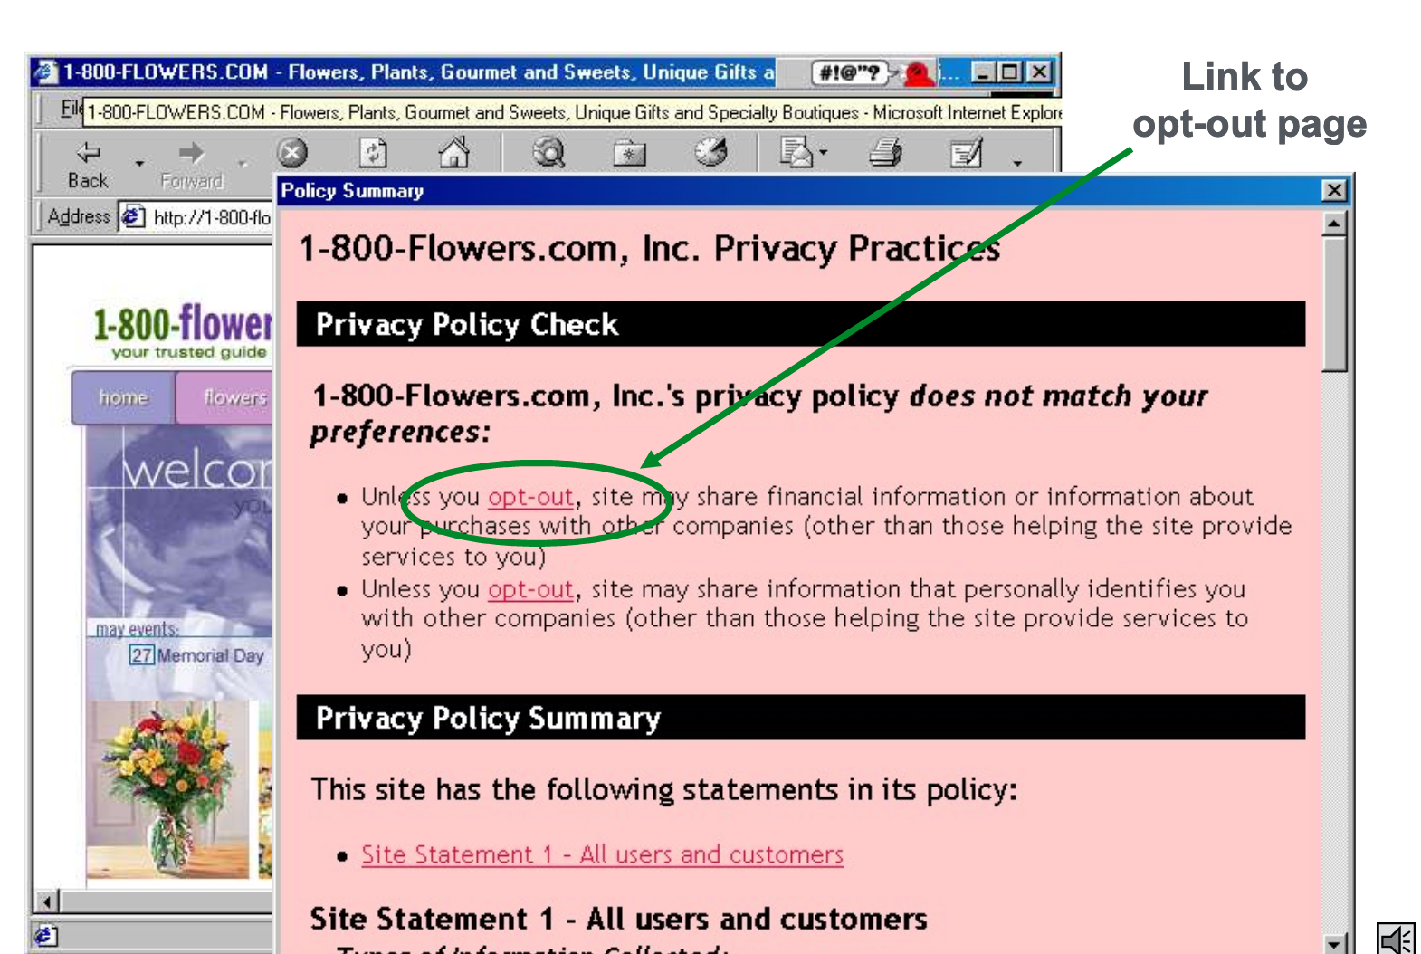
Privacy choices highlighted

Slide 14

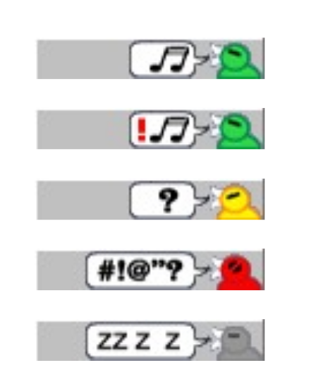
P3P tool: AT&T’s privacy bird
Free download of beta from http://privacybird.com/
IE 5.01/5.5/6.0
Reads P3P policies at all P3P-enabled sites automatically
Puts bird icon at top of browser window that changes to indicate whether site matches user’s privacy preferences
Clicking on bird icon gives more information
Current version is information only – no cookie blocking

Slide 15
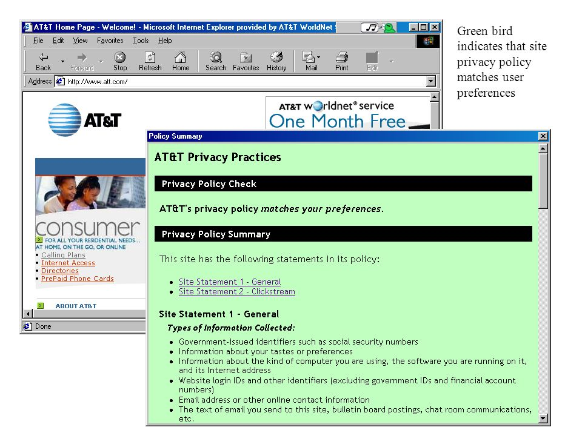
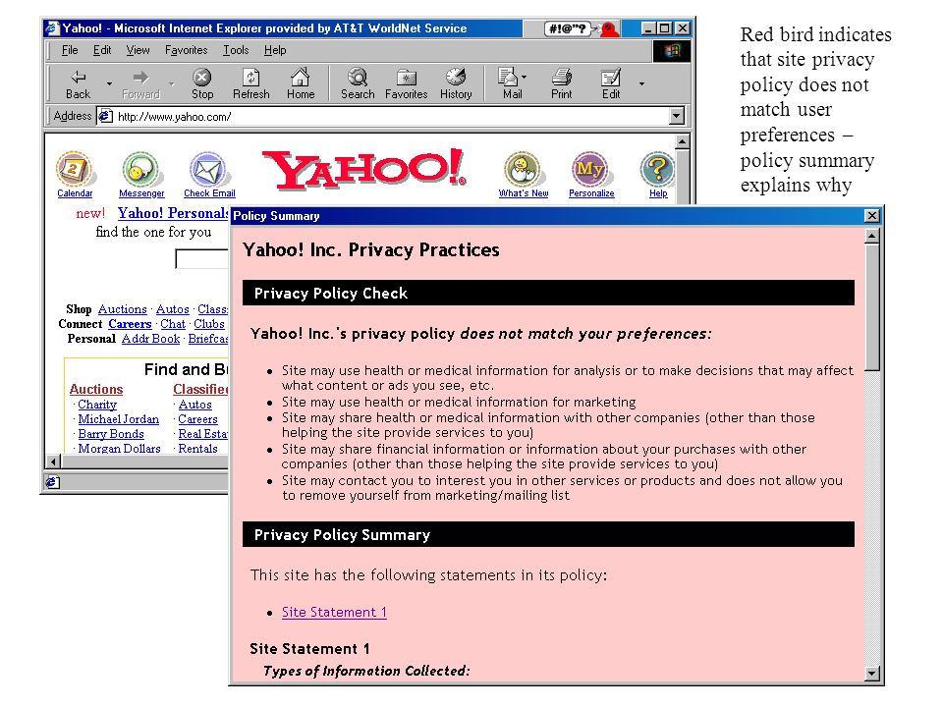
Comparison of two sites

Slide 16
Alternatives to machine-readable policies...
P3P wasn’t adopted
– lacked incentives on the content providers
Extract information from human-readable policies through:
– Natural language processing
– Crowdsourcing

Slide 17
Using Crowdsourcing and NLP+ML

Slide 18

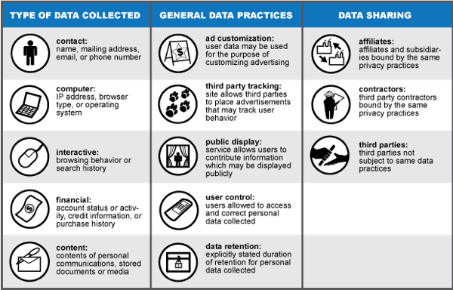
Labelling privacy practices
Types of Data Collected, General Data Collection Practices, and Data Sharing Practices.
Each policy received an evaluation code of YES, NO, or UNCLEAR for each category.
http://www.knowprivacy.org/
https://wiki.mozilla.org/Privacy_Icons

Slide 19
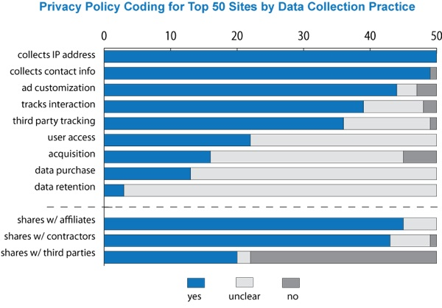
Labelling privacy practices
Websites Collect Data About Users, But Policies Are Unclear About Important Practices

Slide 20
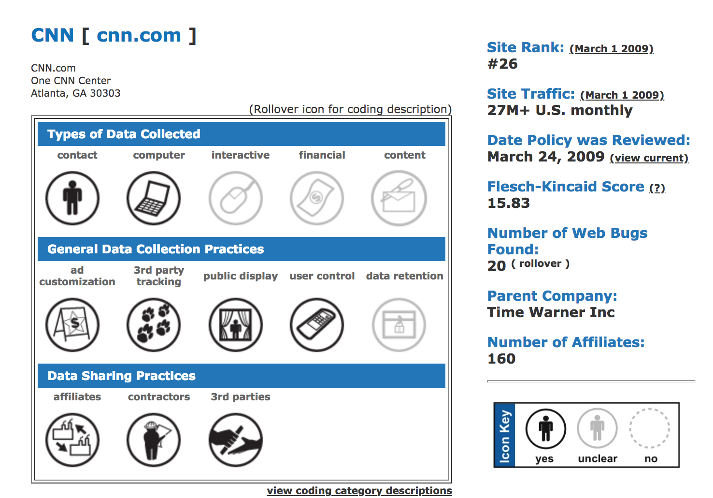
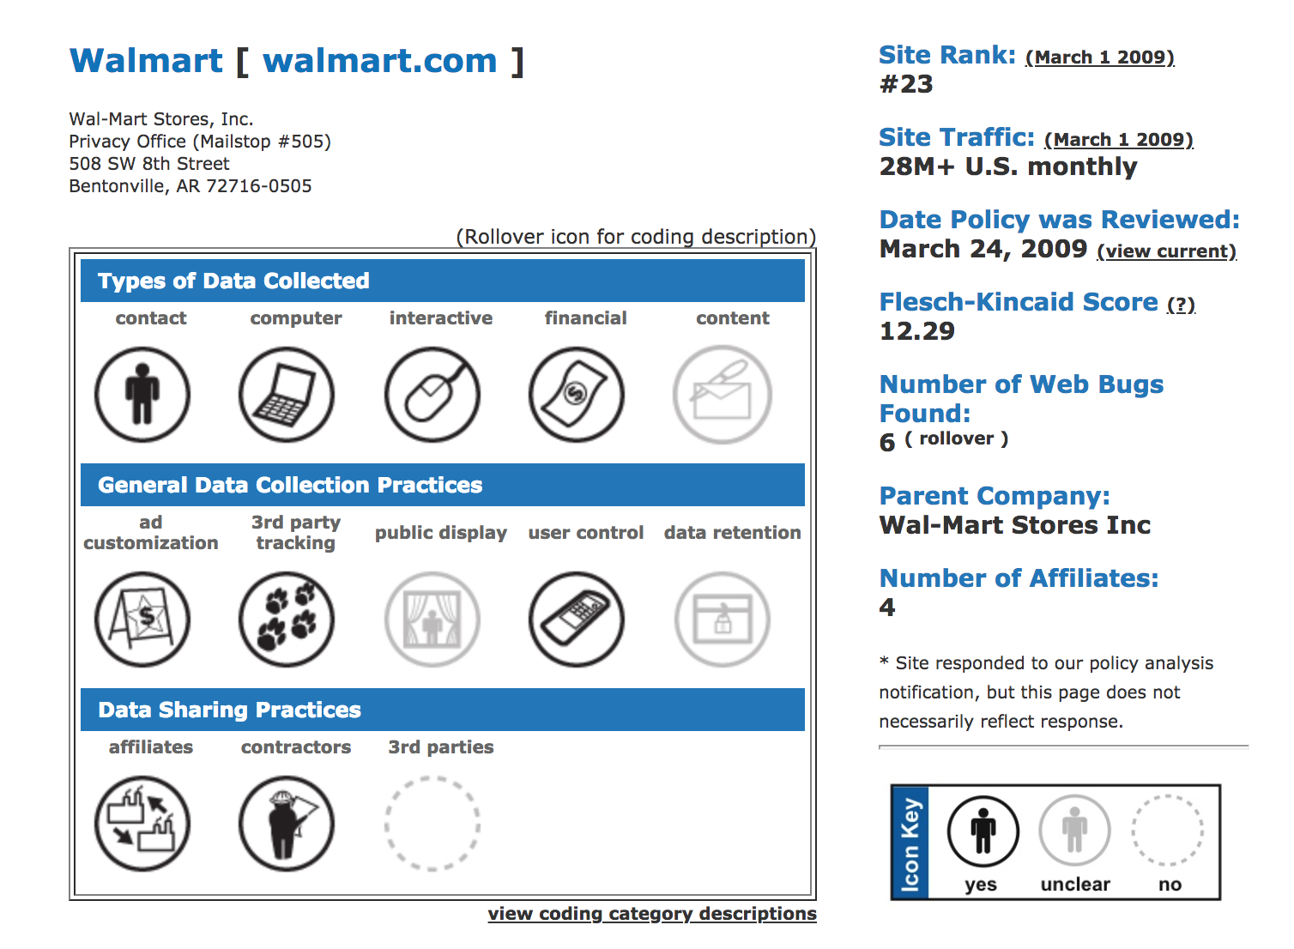
Site-level analysis
http://knowprivacy.org/profiles/index.html

Slide 21
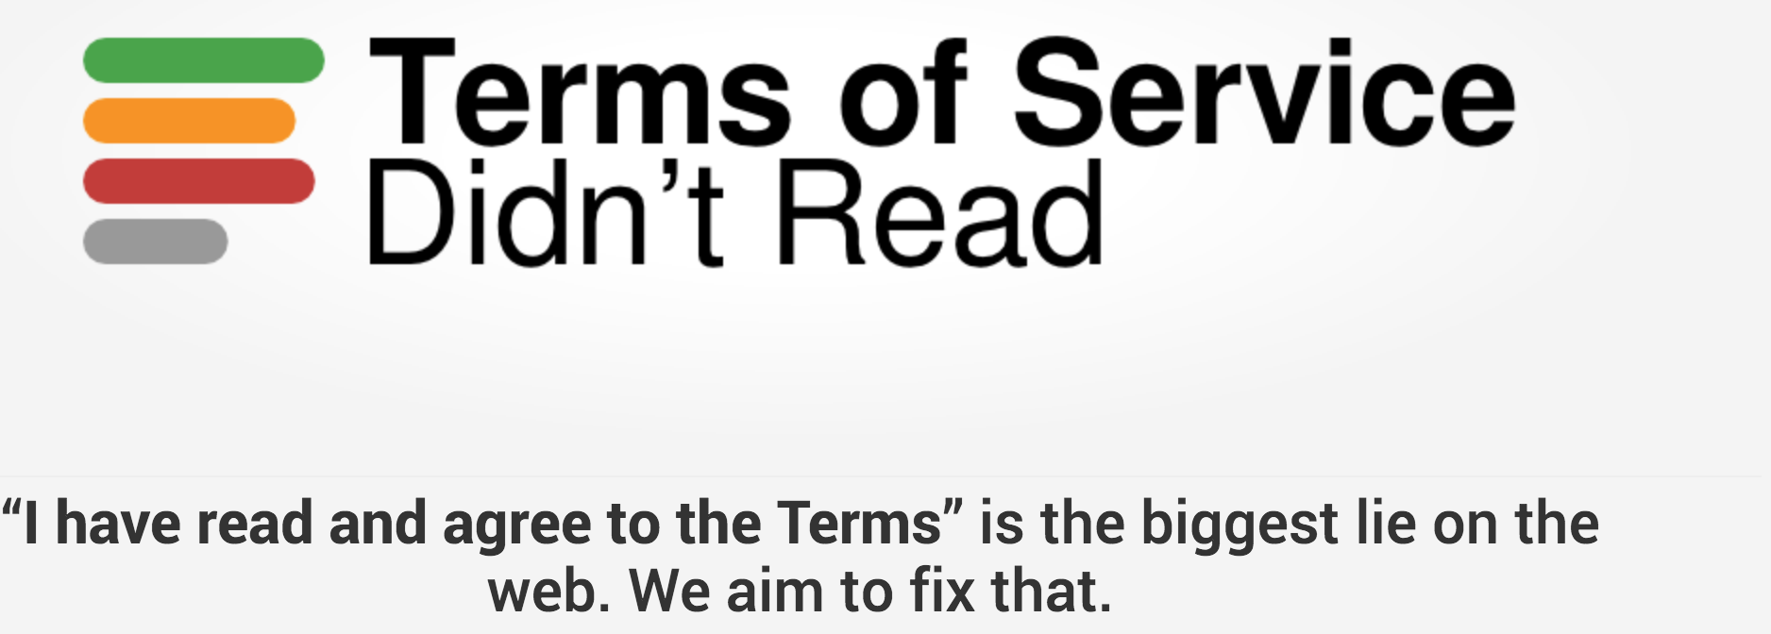
Crowdsourced based labelling and rating
ToS;DR emerged during the 2011 Chaos Communication Camp near Berlin, with people from Unhosted leading a movement to create web apps that give users control over their valuable user data and privacy.
Reviews and rates website’s terms & privacy policies
provide rating from very good (Class A) to bad (Class E)
Open sourced and reviews are done through voluntary contribution
Notes:
The Chaos Communication Camp (also known as CCCamp) is an international meeting of hackers that takes place every four years, organized by the Chaos Computer Club (CCC). So far all CCCamps have been held near Berlin, Germany.
The camp is an event for providing information about technical and societal issues, such as privacy, freedom of information and data security.

Slide 22
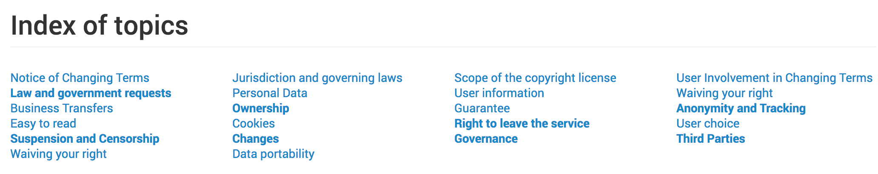
ToS;DR
Terms of service are divided into small points
Each point gets assigned one or several topics
Then topics are scored
A service is a website or online application, for instance YouTube.
A case is an individual remark that can form part of the review of a service, for instance "you need to be 13 years old to use this service"; each is assigned a topic to provide grouping.
A point links a case to a service, for instance "you need to be 13 years old to use YouTube".

Slide 23
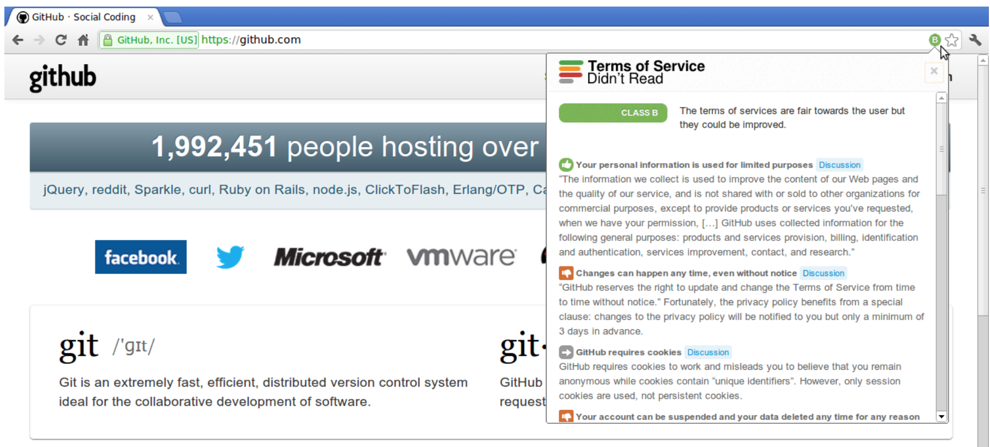
ToS;DR
https://tosdr.org/index.html#services

Slide 24
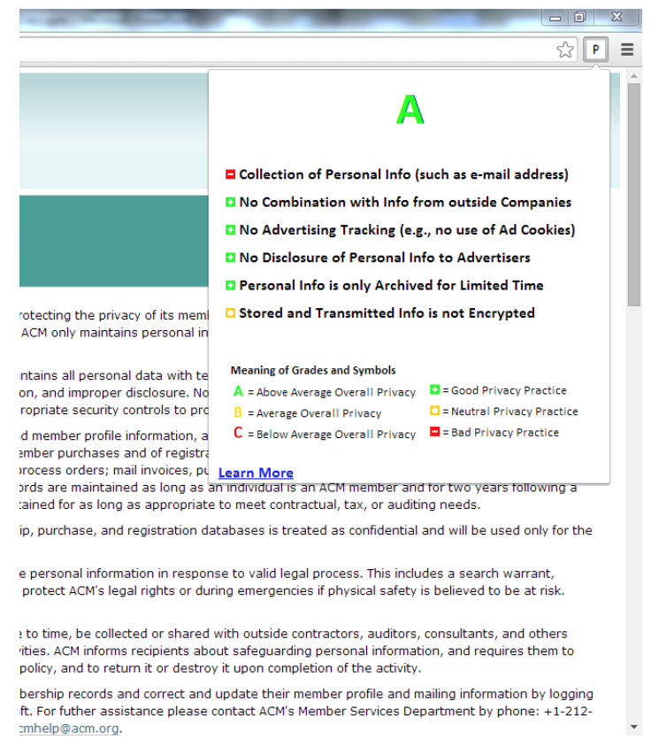
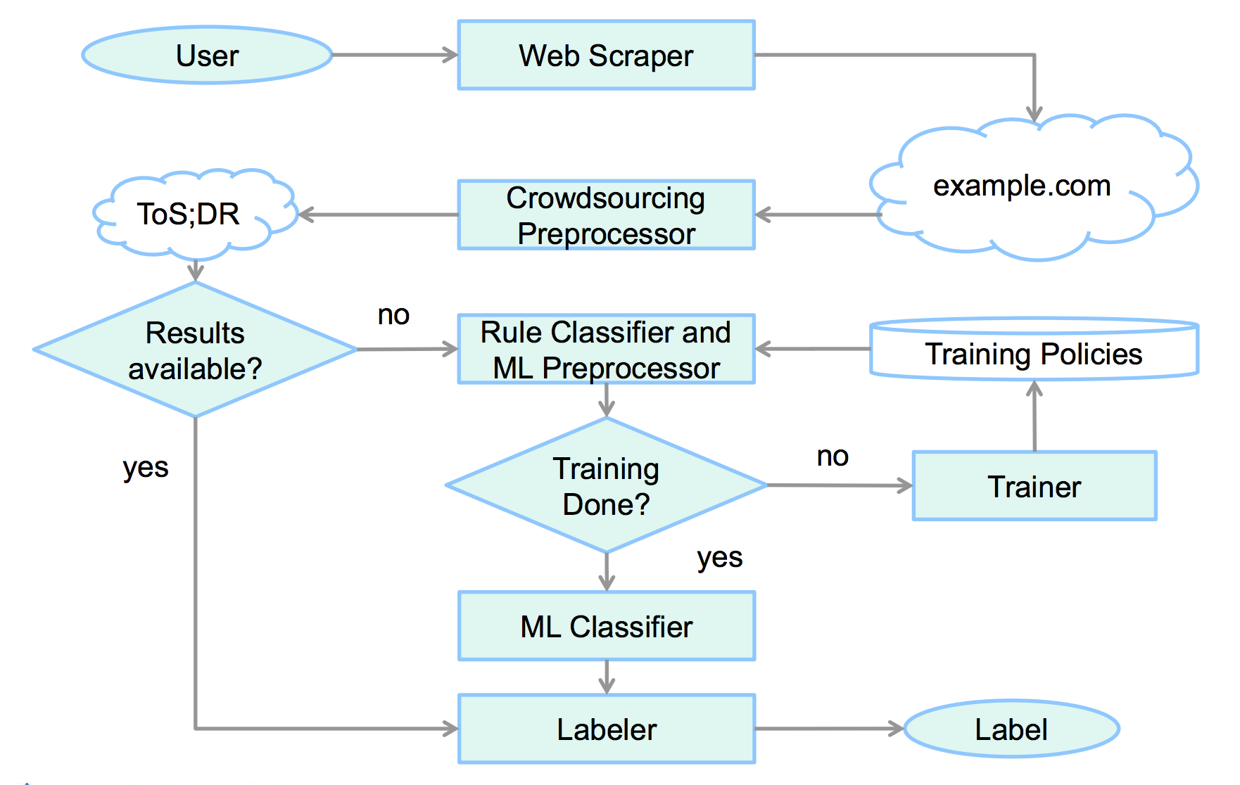
Privee another policy rating extension
Uses NLP techniques to find the presence or absence of topics
Privee: An Architecture for Automatically Analyzing Web Privacy Policies Sebastian Zimmeck and Steven M. Bellovin 23rd USENIX Security Symposium (USENIX Security)

Slide 25
Automated Policy Analysis

Slide 26
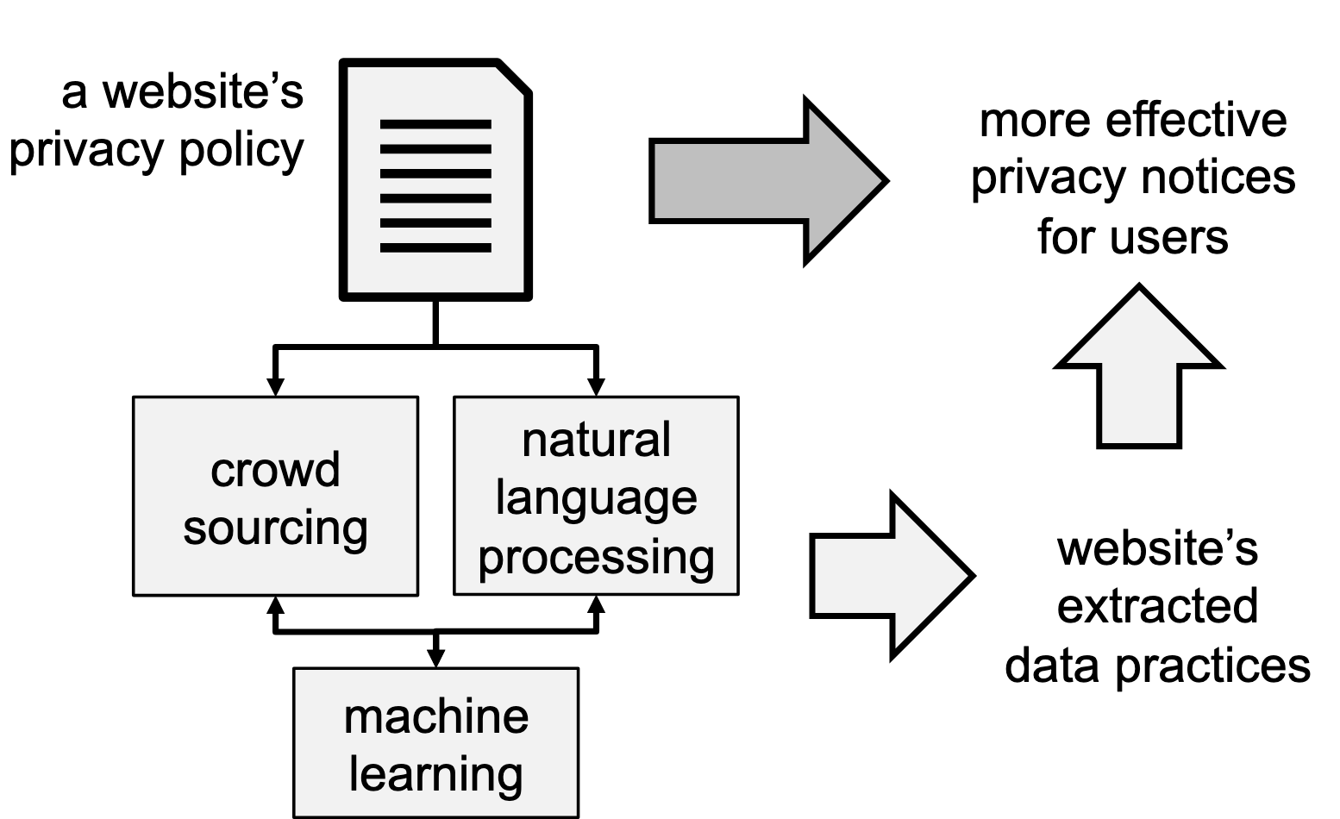
Extract meaningful policy information
Semi-automatically extract data practices from privacy policies by combining crowdsourcing, machine learning & natural language processing

Slide 27
Crowdsourcing privacy policy extraction
Not your typical crowdsourcing task
Challenges
obtain high quality annotations
with manageable cost
from non-expert crowd workers
from complex policy documents

Slide 28
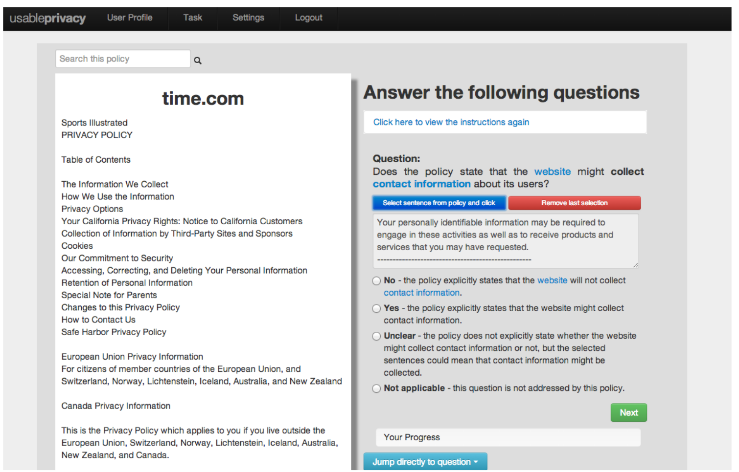
Privacy policy annotation tool
www.usableprivacy.org

Slide 29
Privacy policy annotation tool
Iterative design
Goals & insights
policy and questions visible at same time
clear & accessible instructions
sequential and go-to navigation
sentence selection with undo
concise questions & response options, yet understandable
keyword definitions
unclear is a valid answer
Webanno is another open-source tool

Slide 30

Interpretation of privacy policies
Comparative annotation study with privacy policy experts, skilled annotators, MTurk Crowdworkers on 6 privacy policies
Result Highlights
Data collection relatively easy to identify
Data sharing practices more difficult
Even experts do not always agree
Finer nuances difficult to extract
Policy language too ambiguous
Reidenberg et al., Disagreeable Privacy Policies: Mismatches between Meaning and Users’ Understanding,Berkeley Technology Law Journal (to appear), available on SSRN

Slide 31
How good are crowdworkers?
76% of cases: they agree on same answer as experts*
2% of cases: they agree on different answer than experts*
22% of cases: crowdworkers do not reach agreement
*3 of 4 experts agree on same answer in 90.1% of cases
Crowdworkers agree with experts or not at all
Reidenberg et al., Disagreeable Privacy Policies: Mismatches between Meaning and Users’ Understanding,Berkeley Technology Law Journal (to appear), available on SSRN

Slide 32
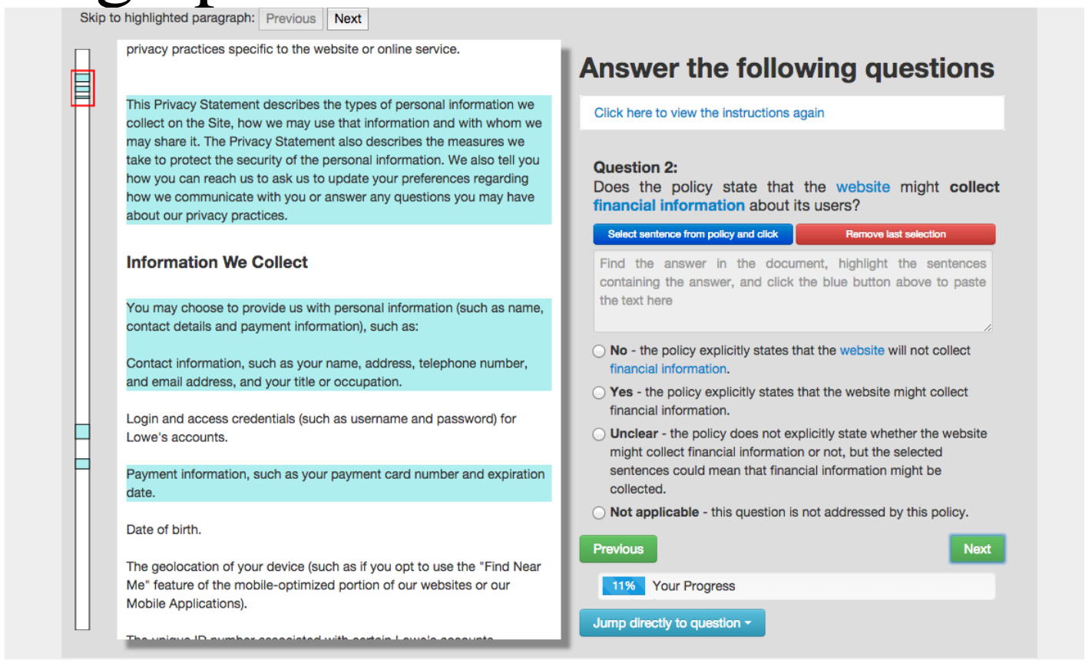
Predicting & highlighting relevant paragraphs
Logistic regression to rank paragraphs based on probability of containing the answer to question x
Regression features: regex matches, n-grams

Slide 33
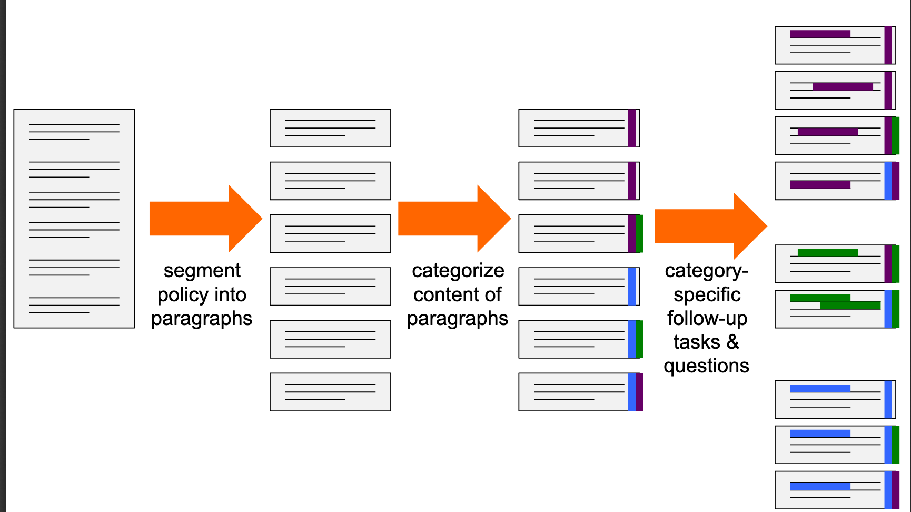
Annotation task workflow

Slide 34
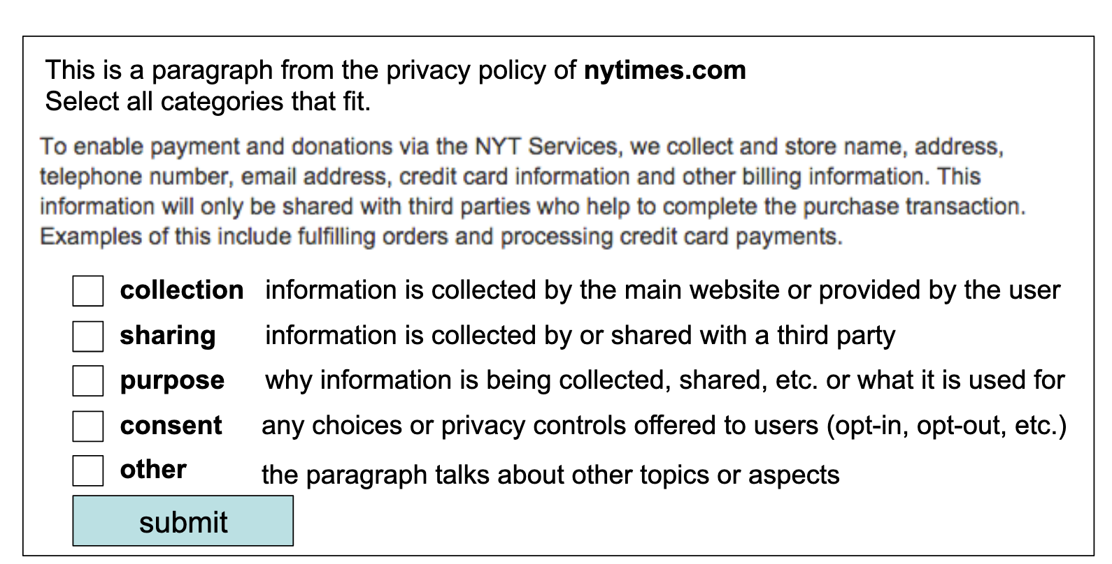
Categorize paragraphs

Slide 35
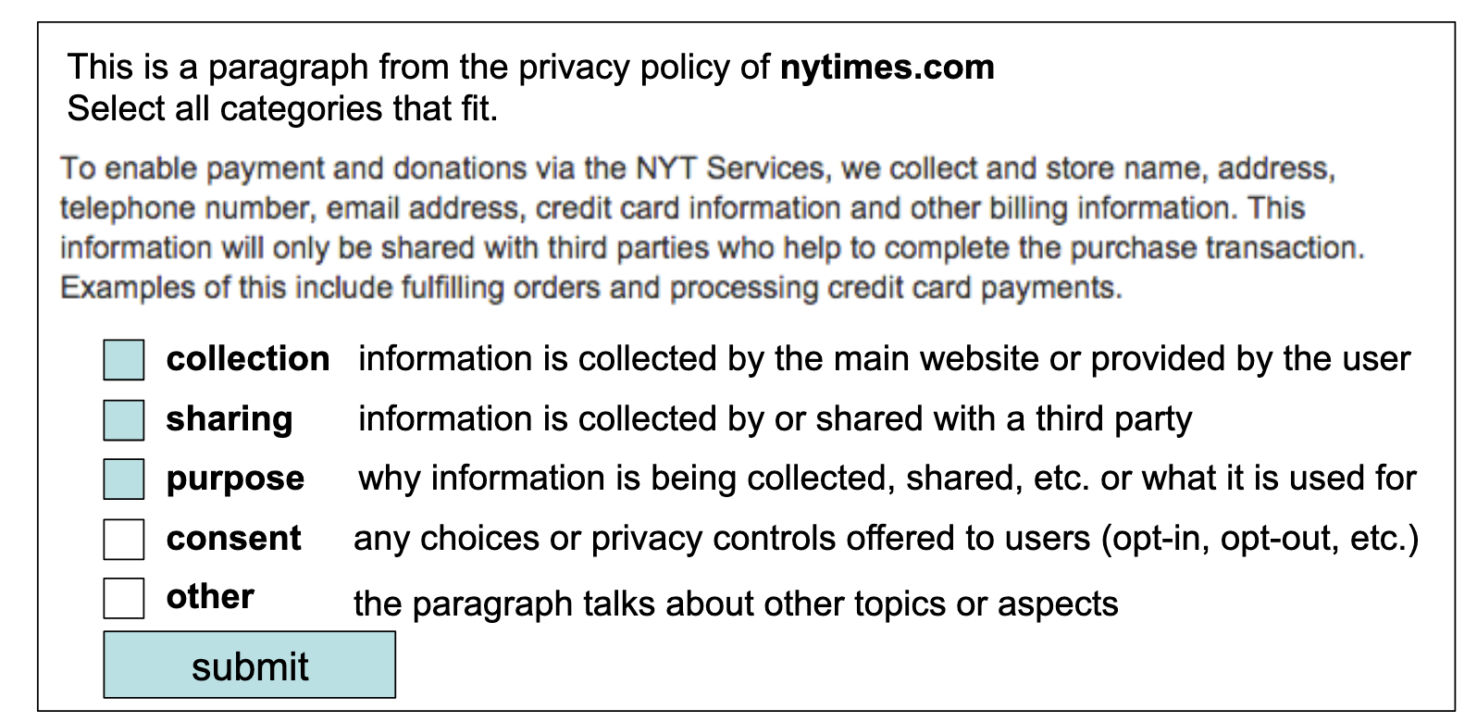
Categorize paragraphs

Slide 36
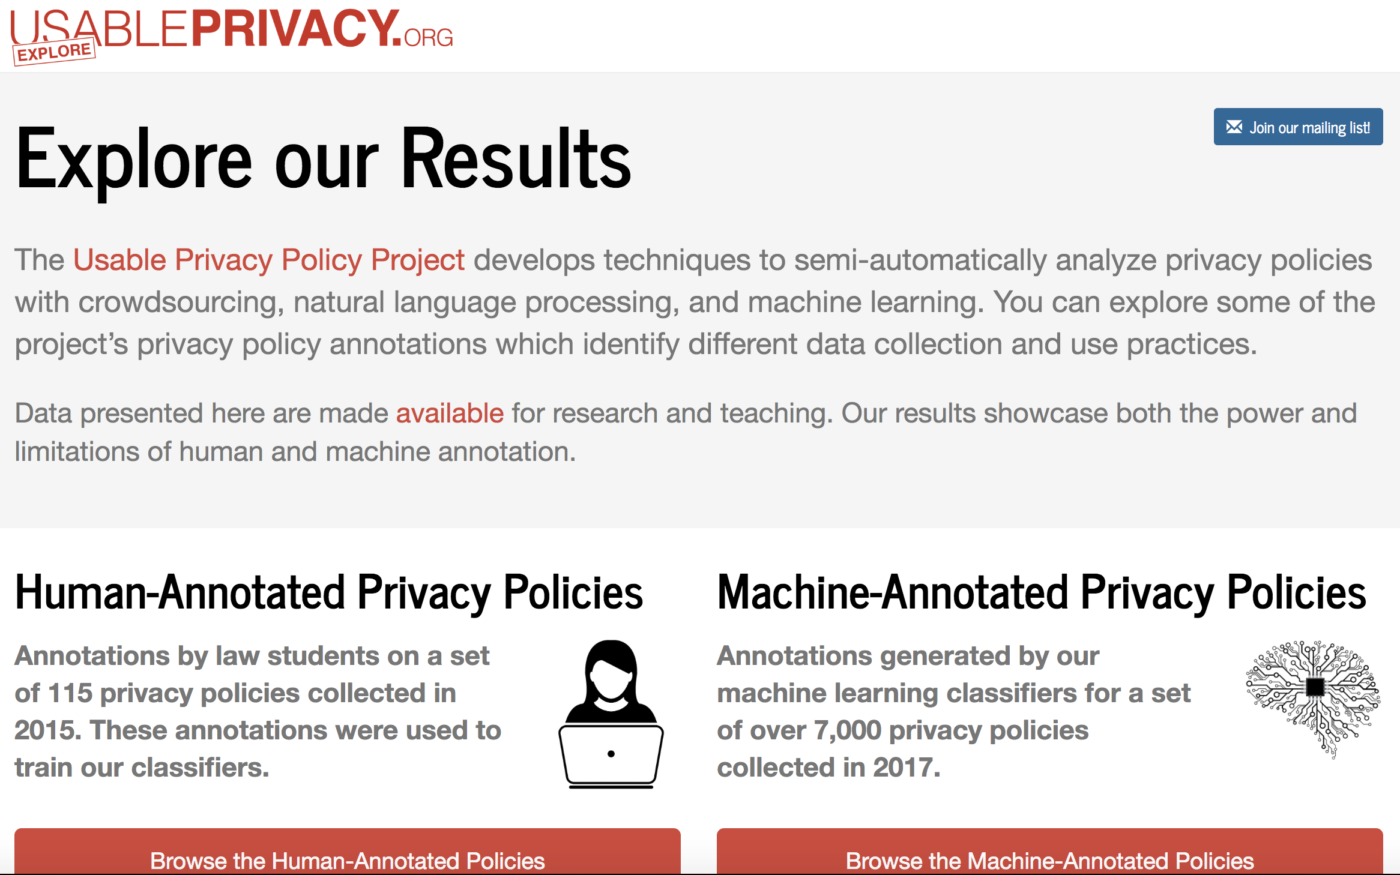
Automated policy analysis

Slide 37
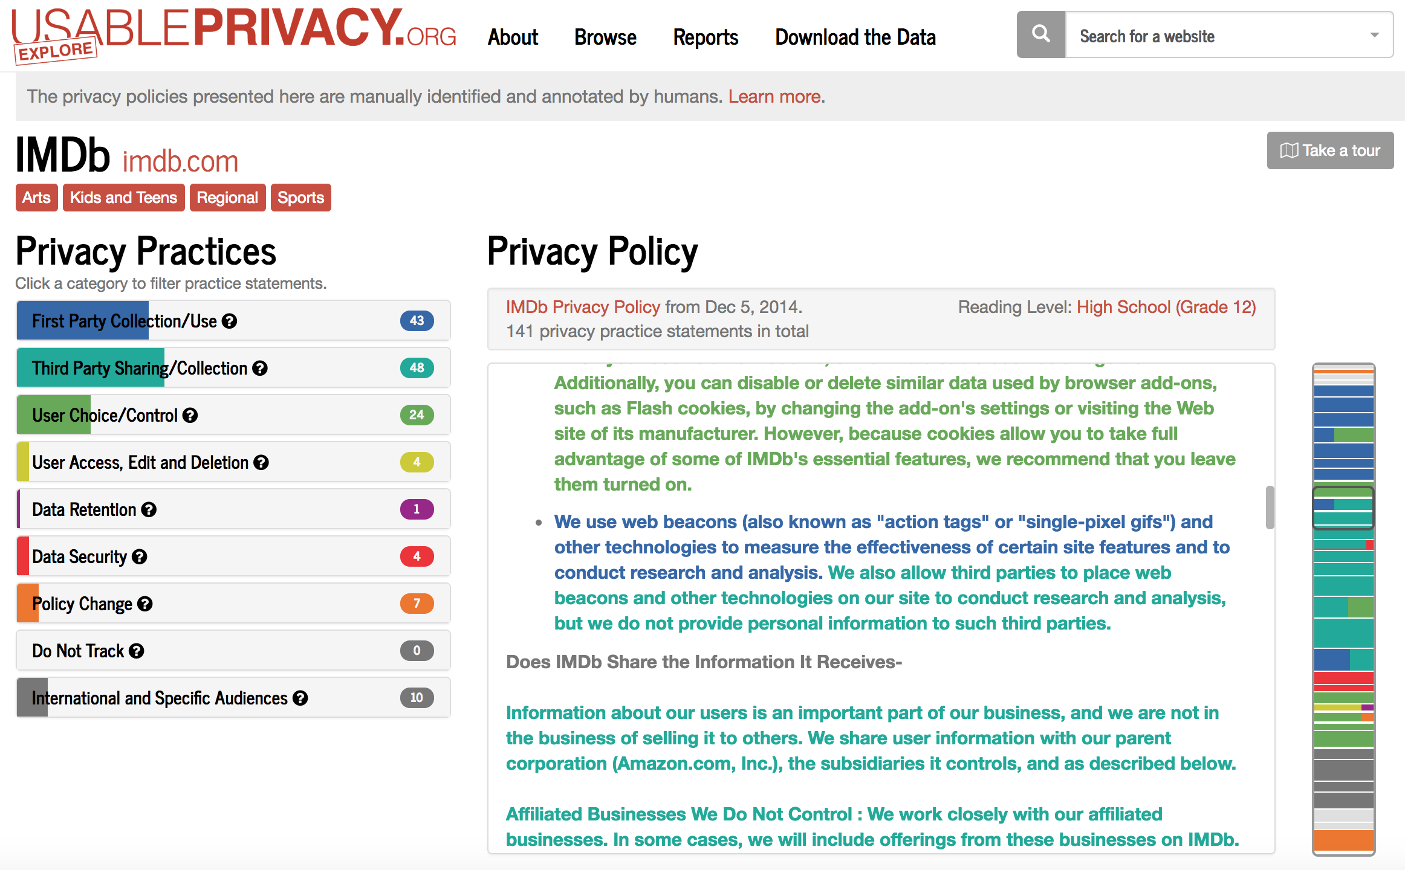
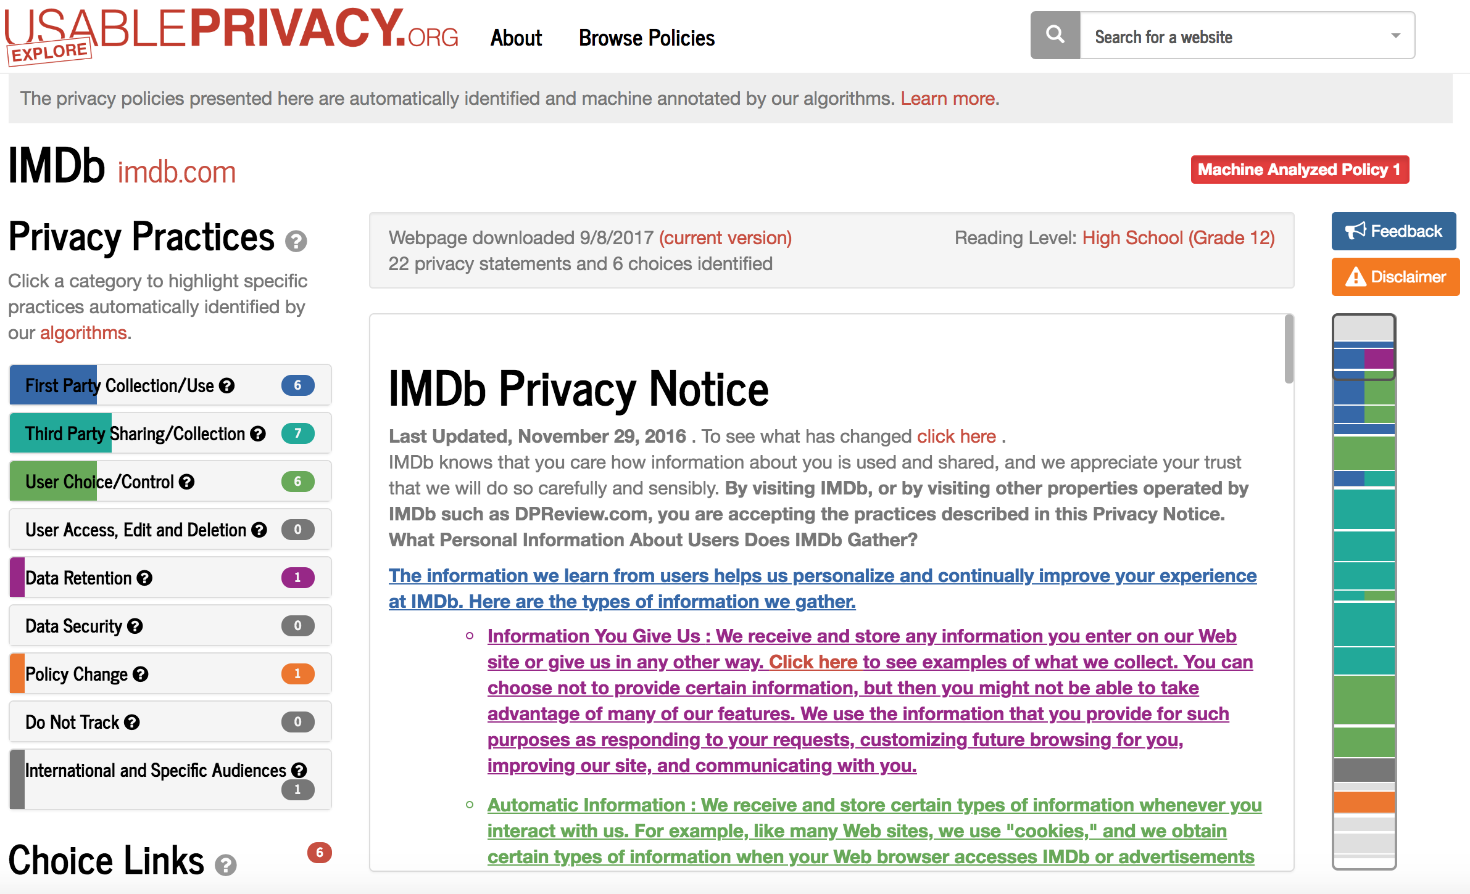
Automated policy analysis
Human (law students)
Machine Learning
NLP and ML is achieving relatively high accuracy

Slide 38
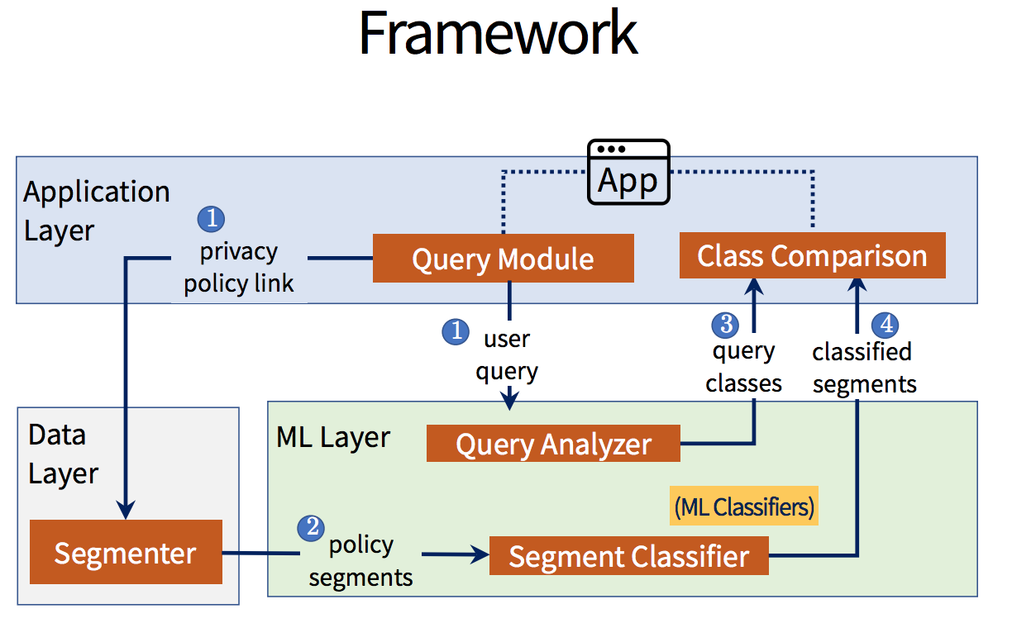
Polisis
Leverages the human annotated policies to automate the annotation of an arbitrary policy
Capable of answering structured and unstructured queries
Polisis: Automated Analysis and Presentation of Privacy Policies Using Deep Learning. Hamza Harkous, Kassem Fawaz, Remi Lebret , Florian Schaub, Kang G. Shin, and Karl Aberer (USENIX 2018)

Slide 39
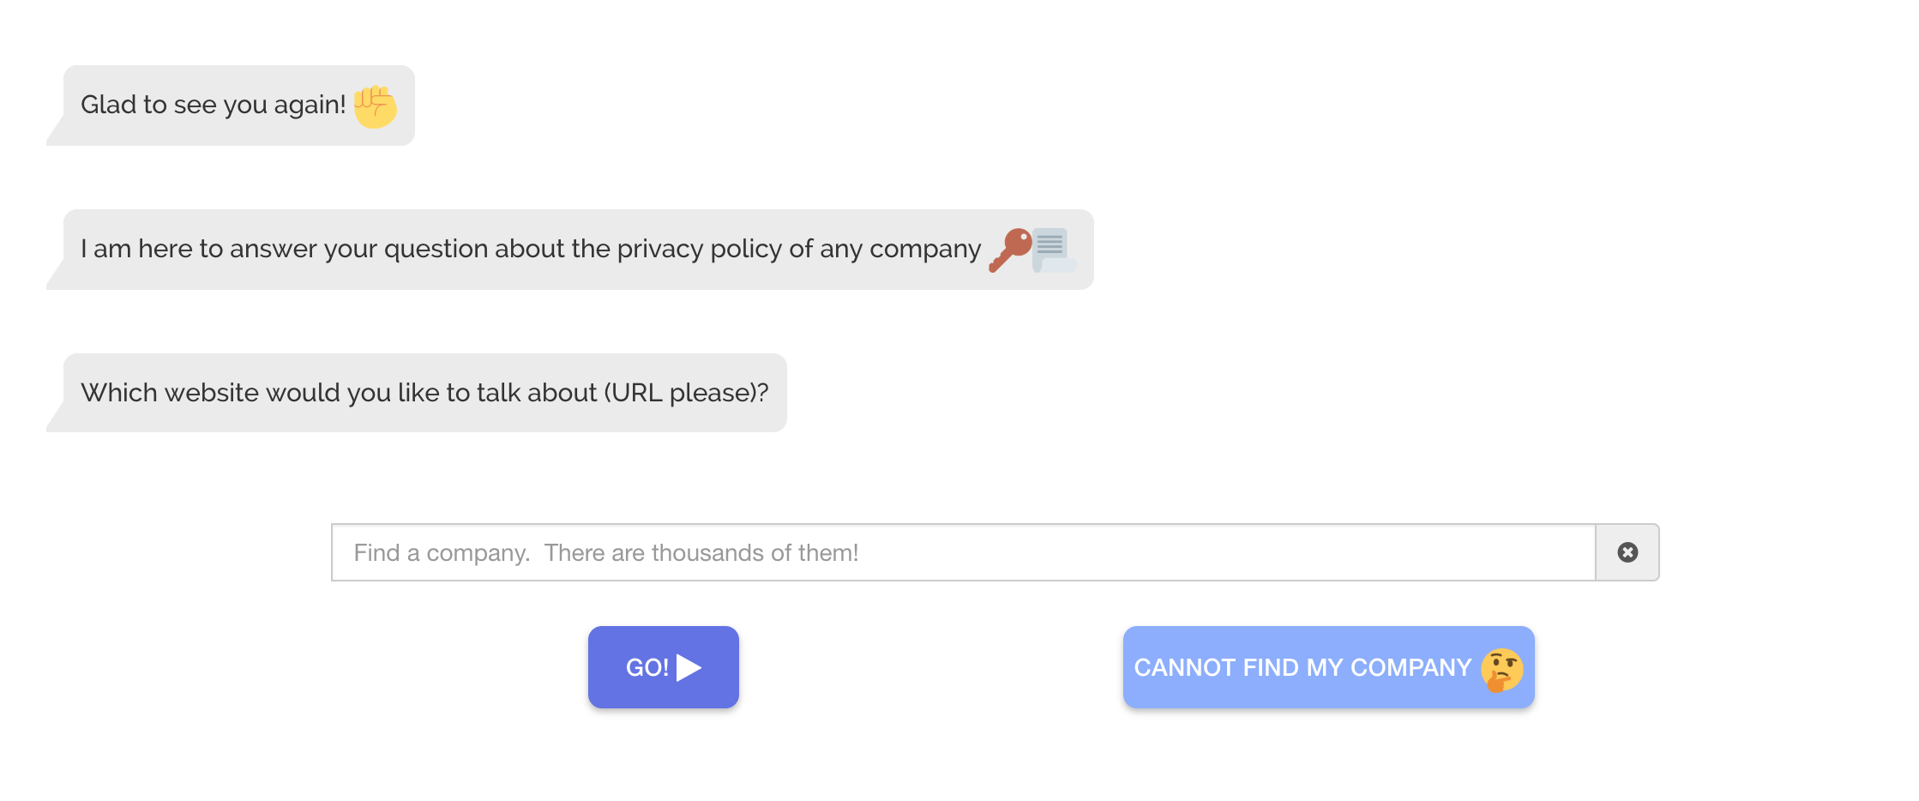
Pribot: answering bot
https://pribot.org/
Polisis: Automated analysis and presentation of privacy policies using deep learning (USENIX 2018)

Slide 40
Mobile app compliance

Slide 41
Mobile app compliance
Motivation
“Google Play requires developers to provide a valid privacy policy when the app requests or handles sensitive user or device information.” (Google Play Developer E-Mail, Feb ’17)
The California Consumer Privacy Act (CCPA) also requires app publishers to have a privacy policy and transparently disclose data practices

Slide 42
Privacy requirements
What are privacy requirements?
Apps must have a privacy policy if personal data is collected
Policies have to describe data practices occurring in the apps (e.g., describe how location data is shared with third parties) and must not omit any practice
Apps must follow the described practices
https://www.privacypolicies.com/blog/mobile-apps-privacy-policy/#Privacy_Policies_For_Android_Apps

Slide 43
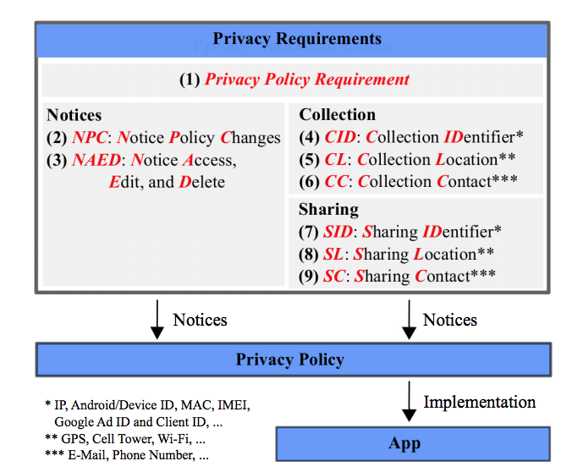
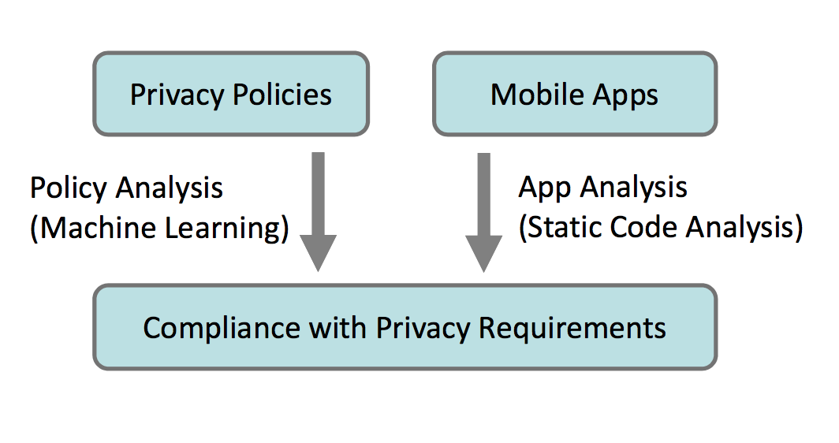
Compare App Behavior/Code to Policy

Slide 44
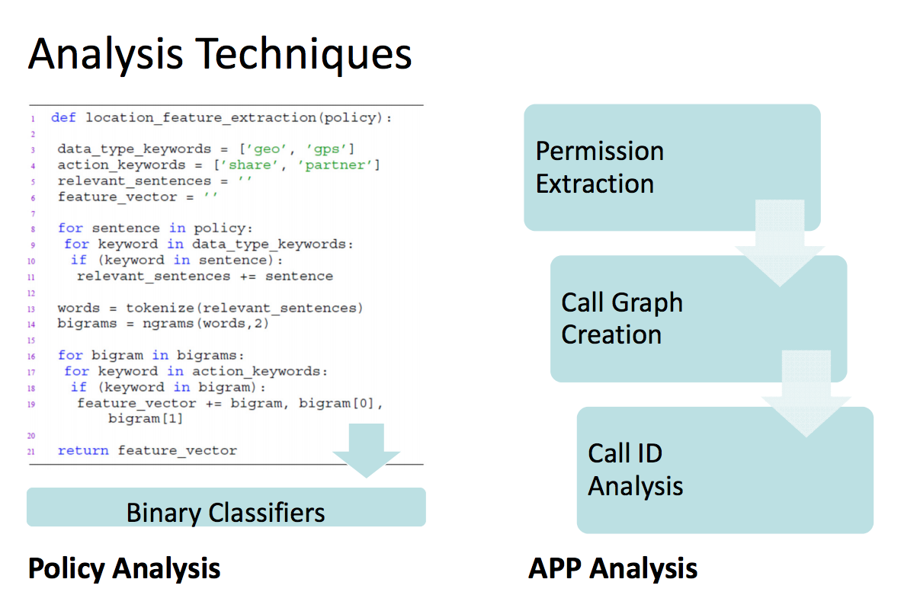
Analysis techniques

Slide 45
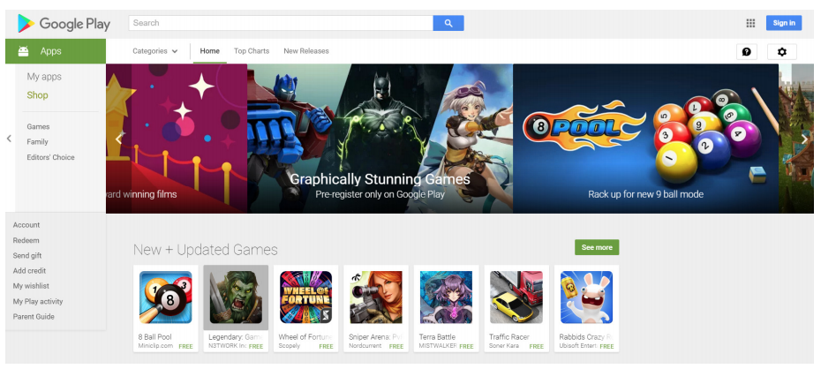
Dataset
17,991 free apps from the Google Play Store and their metadata (e.g., whether an app has a policy link or the number of reviews)
Started crawl from most popular apps in each category and followed links to similar apps
Automated Analysis of Privacy Requirements for Mobile Apps Sebastian Zimmeck, Ziqi Wang, Lieyong Zou, Roger Iyengar, Bin Liu, Florian Schaub, Shomir Wilson, Norman Sadeh, Steven M. Bellovin, and Joel Reidenberg 24th Network & Distributed System Security Symposium (NDSS)

Slide 46
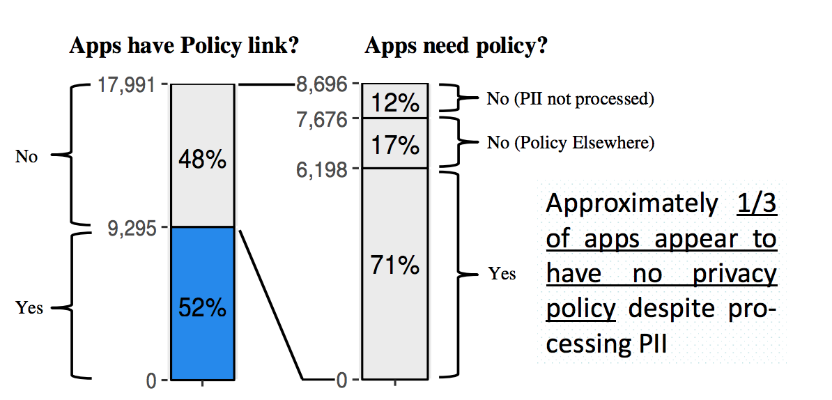
Many apps don’t have a privacy policy
(.48*.71=.34)

Slide 47
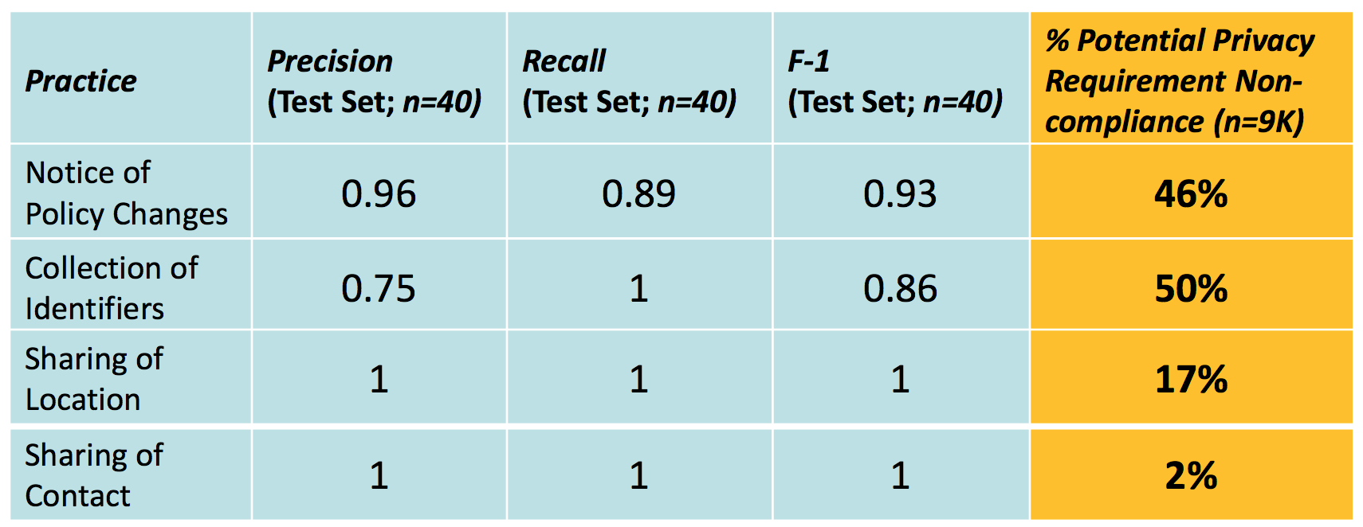
Non-compliance of apps
ML performance
Potential privacy requirement non-compliance can be predicted reliably and at scale

Slide 48
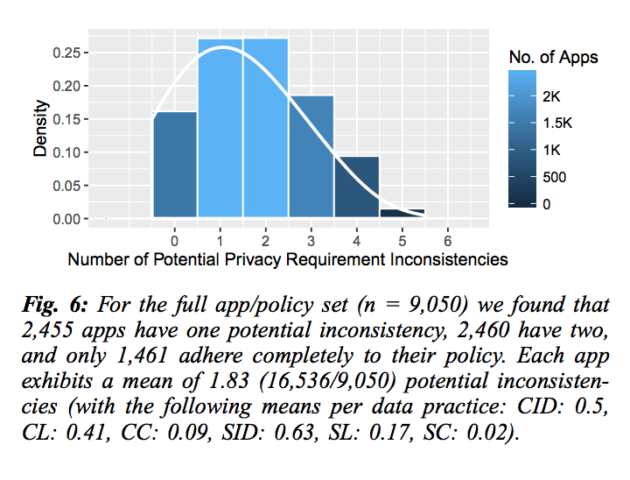
Mean non-compliant apps
Each app exhibits a mean of 1.83 instances of potential privacy requirement non-compliance
Non-compliance does not necessarily mean that a law is violated; manual verification required

Slide 49
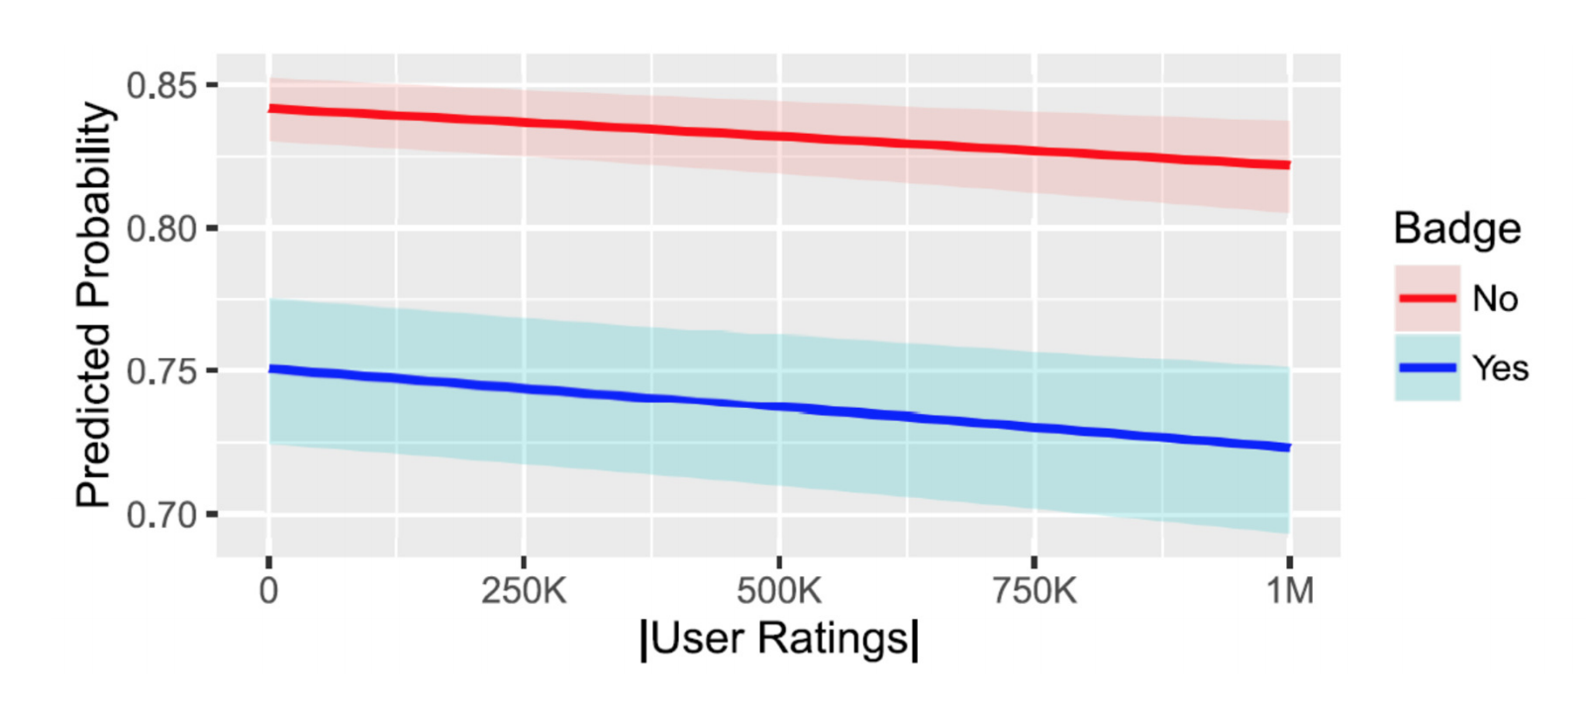
App metadata as predictor for non-compliance
Apps with a Top Developer or Editor’s Choice badge have a nearly 10% lower probability of a potential inconsistency.
Use app metadata to predict which app populations have increased probability of potential privacy requirement noncompliance

Slide 50
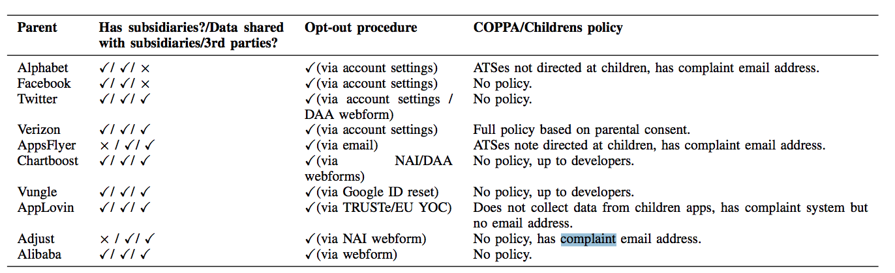
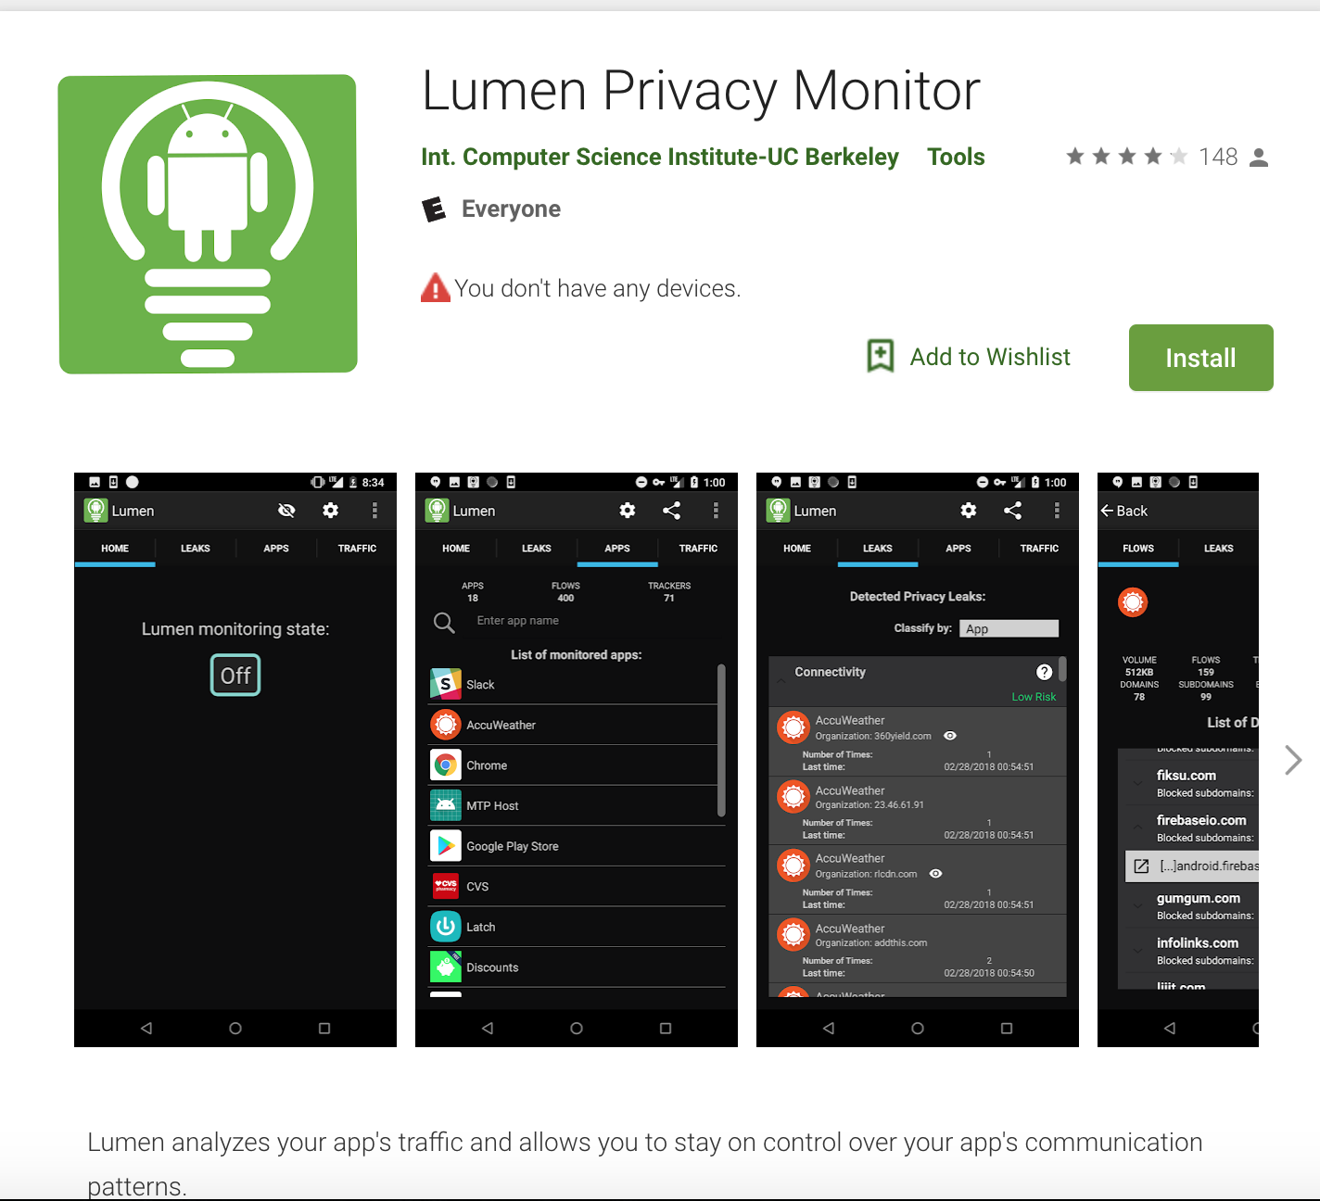
Mobile app tracker analysis
Apps, Trackers, Privacy, and Regulators: A Global Study of the Mobile Tracking Ecosystem. Abbas Razaghpanah, Rishab Nithyanand, Narseo Vallina-Rodriguez, Srikanth Sundaresan, Mark Allman, Christian Kreibich, Phillipa GillNetwork and Distributed System Security Symposium (NDSS), 2018

Slide 51
Post GDPR analysis

Slide 52
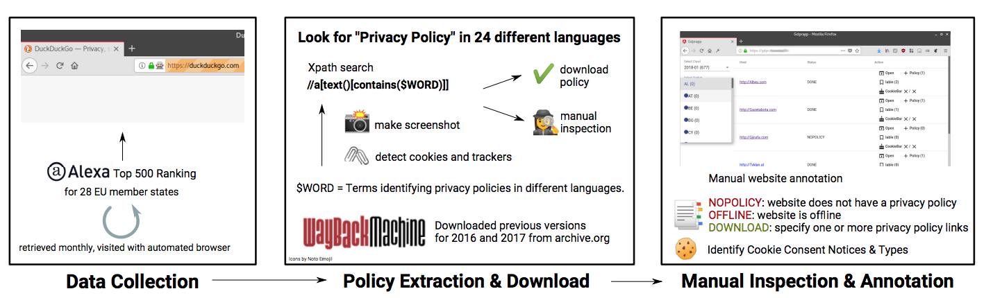
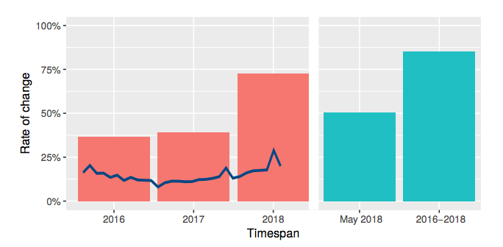
GDPR compliance for web services
We Value Your Privacy ... Now Take Some Cookies: Measuring the GDPR’s Impact on Web Privacy. Martin Degeling , Christine Utz , Christopher Lentzsch , Henry Hosseini , Florian Schaub, and Thorsten Holz. (NDSS 2018)
Privacy policy change

Slide 53
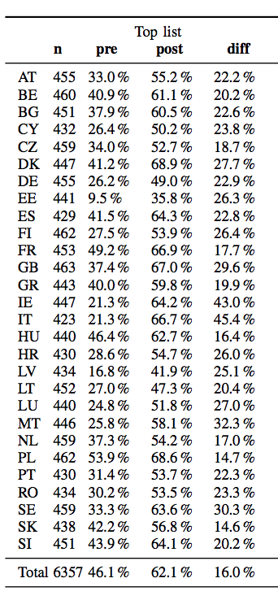
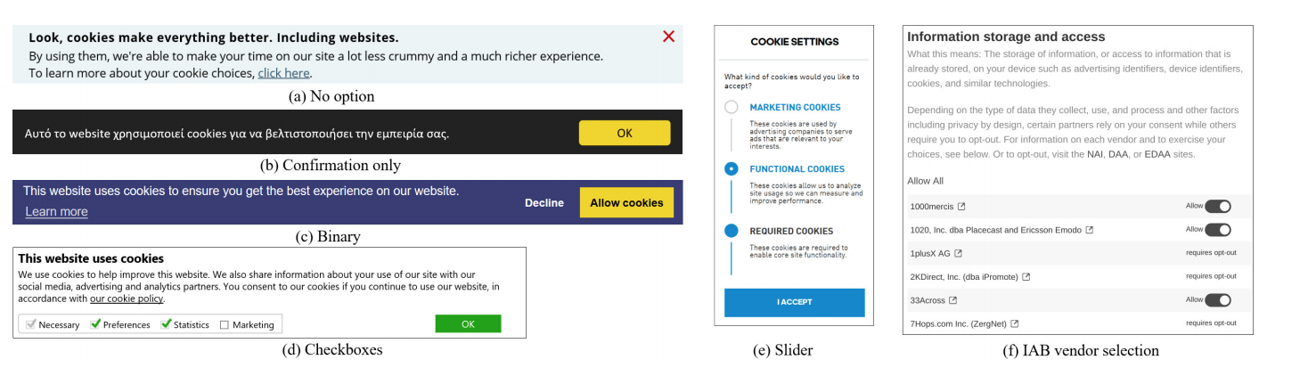
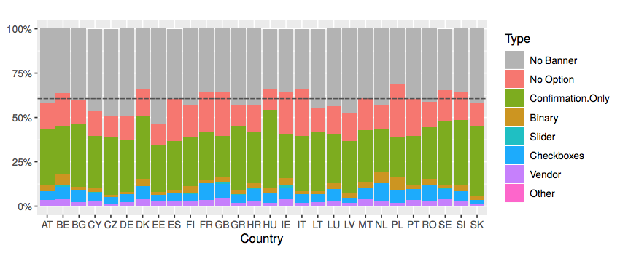
Change is cookies due to GDPR

Slide 54
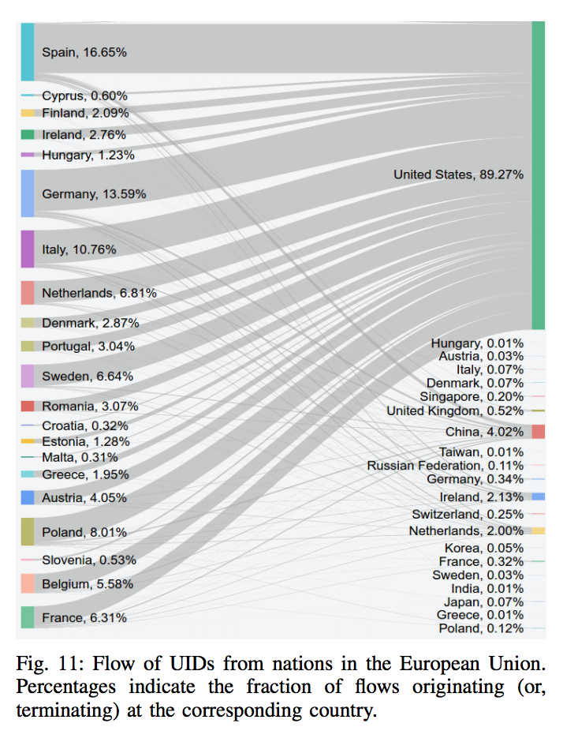
Mobile traffic
What is the main issue here?
Which country going to impacted?
Apps, Trackers, Privacy, and Regulators: A Global Study of the Mobile Tracking Ecosystem. Abbas Razaghpanah, Rishab Nithyanand, Narseo Vallina-Rodriguez, Srikanth Sundaresan, Mark Allman, Christian Kreibich, Phillipa GillNetwork and Distributed System Security Symposium (NDSS), 2018

Slide 55
Logistics
Homework 4 due Oct 23 @11:59pm

